Slide 1

Project management and employee profile building platform for city level departments
Name of students : Om Jangam ,Prashant Karad, Aniruddha Kulkarni, Parul Kulkarni
Guide- Mr. Anand Deshmukh
Seminar
PES Modern College of Engineering Department of Computer Engineering Savitribai Phule Pune University
27-January-2025
27-January-2025

Slide 2




Outline
Introduction Literature survey Objectives and Scope Problem Statement Architectural Diagram Algorithmic Approach Input / Data sets
Results/Experimental Work Conclusion / Summary References
1
2
3
4
5
6
7
8
9
10
27-January-2025

Slide 3
Introduction
In the constantly evolving and fast paced world, increasing efficiency of project management is very important.
This project provides a solution to manage various tasks related to city level department project.
Employee profile building platform is also included in the solution.
With the help of this project the department can easily handle many projects.
27-January-2025

Slide 4
Literature Survey(1/2)
Title | Author(s), Publication Year | Technique | Remark
Web-Based Project Collaboration, Monitoring, and Management System | G. A. D. Pradeepa, S. Seneviratna, S. T. Nandasara, 2015 | Collaboration Tools, Project Tracking | Focuses on collaboration across different departments and teams. Covers project tracking, communication, and resource sharing across multiple entities, relevant to inter-departmental cooperation.
Usability-Software Development Life Cycle (U-SDLC) | Velmourougan S, Dhavachelvan P, Baskaran R, Ravikumar B, 2014 | Usability in SDLC (Software Development Life Cycle) | Focuses on the integration of usability throughout the SDLC process. Highlights how neglecting usability can lead to costly flaws, proposing a model to incorporate usability tasks in every SDLC phase.
Table 1:-Literature Survey
27-January-2025

Slide 5
Literature Survey(2/2)
Title | Author(s), Publication Year | Technique | Remark
Web Development and Performance Comparison of Web Development Technologies in Node.js and Python | Sai Sri Nandan Challapalli, Prakarsh Kaushik, Shashikant Suman, Basu Dev Shivahare, Vimal Bibhu, Amar Deep Gupta, IEEE, 2021 | Node.js, Python, Performance Comparison | Discusses the evolution of website development, mobile optimization, and compares the performance of Node.js and Python using Locust and Autocannon under similar conditions.
Leveraging MongoDB for Efficient Data Storage in MERN | Naren Chaudhary, Neetu Mittal, IEEE, 2024 | MongoDB, MERN Stack | Investigates the use of MongoDB in MERN stack applications for efficient data storage, emphasizing MongoDB's scalability, security, and flexibility for dynamic web development.
Table 1:-Literature Survey
Table 2:-Literature Survey
27-January-2025

Slide 6
Objectives and Scope
To build a platform where tasks related to the project development can be handled
To build a platform where the employee can build their profile which includes the details of the employee, past project contribution, skill set, work experience, etc.
To build a platform where all the projects of a department can be easily viewed
The scope of the project extends to the various departments and their projects present at the city level
27-January-2025

Slide 7
Problem Statement
To develop a web application for city level departments for project management and employee profile building.
27-January-2025

Slide 8
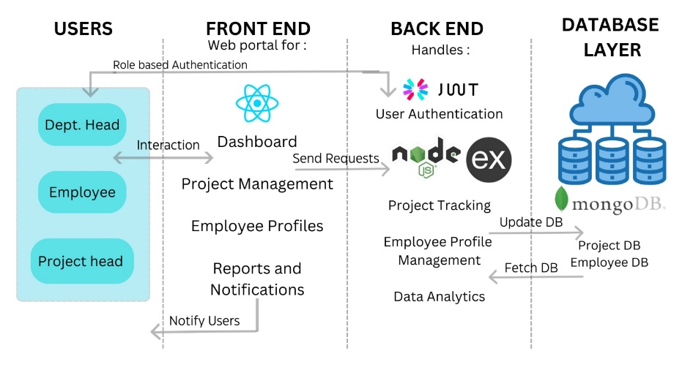
Architectural Diagram
Figure: 1.System Architectural Diagram.
27-January-2025

Slide 9
Algorithmic Approach(1/2)
Algorithm objective and Selection :
to retrieve data from database
To analyze database data
To search for required data
To optimize task assignment
2. Steps of the Algorithm :
Gather requirement for the request from the user
Fetch the required API’s
Apply searching and sorting algorithms
Apply analyzing algorithms
3. Efficiency Considerations :
Faster data retrieval
Low cost of algorithm working
27-January-2025

Slide 10
Algorithmic approach(2/2)
4. Optimization :
Based on the cost of various algorithms, select the best algorithm for a particular task
5. Testing :
Test for the various user inputs
6. Impact on Project :
- improved work flow of the project
27-January-2025

Slide 11
Input / Dataset
The existing data can be collected from the various departments which will be using the project solution and from the city website
The department project data is to be entered as input by the department whose project is under development
27-January-2025

Slide 12
Conclusion
The platform will help in improving efficiency of project management.
It becomes easier to get the overview of the department project
Various tasks related to the project management are handled by a single platform
The project is managed in a more structured digital way
The employee profile building is included in the project
27-January-2025

Slide 13
References I
Challapalli, S. S. N., Kaushik, P., Suman, S., Shivahare, B. D., Bibhu, V., & Gupta, A. D. (2021). Web Development and Performance Comparison of Web Development Technologies in Node.js and Python. IEEE. DOI: 10.1109/ICTAI53825.2021.9673464.
Chaudhary, N., & Mittal, N. (2024). Leveraging MongoDB for Efficient Data Storage in MERN. IEEE. DOI: 10.1109/ICRITO61523.2024.10522103.
Pradeepa, G. A. D., Seneviratna, S. S., & Nandasara, S. T. (2014). Web-Based Project Collaboration, Monitoring and Management System. IEEE. DOI: 10.1109/ICTER.2014.7083888.
27-January-2025

Slide 14
References II
4. Velmourougan, S., Dhavachelvan, P., Baskaran, R., & Ravikumar, B. (2014). Software Development Life Cycle Model to Build Software Applications with Usability IEEE. DOI: 10.1109/ICACCI.2014.6968610.
5. Lock, D. (2007). Project Management for the Public Sector: A Guide to the Management of Public Sector Projects. Gower Publishing.
6. Gloor, P. A., et al. (2015). Employee Profile Management: Systems for Knowledge and Performance. Journal of Knowledge Management, 19(4), 623-637.
7. Various Authors. (2017). Collaboration and Task Management in Large-Scale Projects: Insights from a Global Workforce. International Journal of Project Management, 35(5), 927-937.
27-January-2025

Slide 15

27-January-2025

